Slide 1
Introduction to CI/CD
Continuous Delivery

Slide 2
Agenda
What CD stands for
Continuous deployment
Deployment pipeline
Deployment scripting
Automated acceptance testing
Non-functional testing
Deploying and releasing
Continuous delivery
Managing infrastructure and environments
Managing data
Managing components and dependencies
Am I doing CD?

Slide 3

What CD stands for
Publish
Deploy
Release
Deliver
Notes:
Deploy - Copying the software where it needs to be to run and putting it into a running state.
Release -Making software available to your users. This could be by uploading your image or library to a repository, or by setting a configuration value to direct a percentage of traffic to a deployed instance.
Publishing - Copying software to a repository (a storage location for software)—for example, by uploading your image or library to a package registry.
Continuous delivery is a set of goals that we aim for -> implies CI +- CD

Slide 4
Continuous deployment
Continuous deployment is a strategy for software releases wherein any code commit that passes the automated testing phase is automatically* released into the production environment, making changes that are visible to the software's users.
Source code
Task 1
Task 2
Task 3
Generic Pipeline
Notes:
Continuous deployment is a strategy for software releases wherein any code commit that passes the automated testing phase is automatically released into the production environment, making changes that are visible to the software's users.
To achieve this, a deployment pipeline is used. At an abstract level, a deployment pipeline is an automated manifestation of your process for getting software from version control into the hands of your users.
CD pipelines almost always take source code as an input.
Tasks are individual things you can do; you can think of them a lot like functions. And pipelines are like the entry point to code, which calls all the functions at the right time, in the right order.

Slide 5
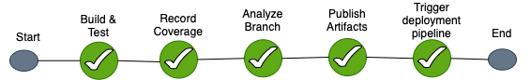
Deployment pipeline | Build
A deployment pipeline starts from the Build & Test step
The CI pipeline is part of a deployment pipeline
The CI pipeline and the CD pipeline can be merged
As such, the steps below can be added to an existing CI pipeline to turn it into a CD pipeline
All steps are running without user interaction

Slide 6
Deployment pipeline
Once the build process completes, the release goes through a deployment pipeline
Two manual judgement steps offer the developer the possibility to rollback changes, even if all the stages had been successful. This gives the team full control over the deployment.
Deploy Pre-prod
Acceptance tests for Pre-prod
Deploy to Prod?
Deploy Prod
Acceptance tests for Prod
Finish?
Notes:
The pipeline mainly consists:
deployment of the code to the Pre-prod environment;
acceptance testing against the Pre-prod environment;
deployment of the code to the Prod environment;
acceptance testing against the Prod environment.
Even with all the testing, things may go wrong. For instance, the acceptance tests might fail in Pre-prod or Prod. In this case, rollback should happen.

Slide 7
Deployment pipeline | Pre-prod fails
If the acceptance tests fail on Pre-prod, the pipeline will rollback the changes in Pre-prod
Having automated and manual rollbacks in place will also help to avoid publishing bugs to production in the case there is a problem that was detected by the tests or by the tester and will also minimize the time to fix a broken deployment
Deploy pre-prod
Acceptance tests for pre-prod
Rollback Pre-prod
Notes:
The pipeline mainly consists:
deployment of the code to the Pre-prod environment;
acceptance testing against the Pre-prod environment;
deployment of the code to the Prod environment;
acceptance testing against the Prod environment.
Even with all the testing, things may go wrong. For instance, the acceptance tests might fail in Pre-prod or Prod. In this case, rollback should happen.

Slide 8
Deployment pipeline | Prod fails
If the acceptance tests fail in Prod, the pipeline will rollback the changes in Prod and Pre-prod. The rollback should happen for all environments that were deployed prior to production.
Deploy Pre-prod
Acceptance tests for Pre-prod
Deploy to Prod?
Deploy Prod
Acceptance tests for Prod
Rollback Prod
Rollback Pre-prod
Notes:
The pipeline mainly consists:
deployment of the code to the Pre-prod environment;
acceptance testing against the Pre-prod environment;
deployment of the code to the Prod environment;
acceptance testing against the Prod environment.
Even with all the testing, things may go wrong. For instance, the acceptance tests might fail in Pre-prod or Prod. In this case, rollback should happen.

Slide 9
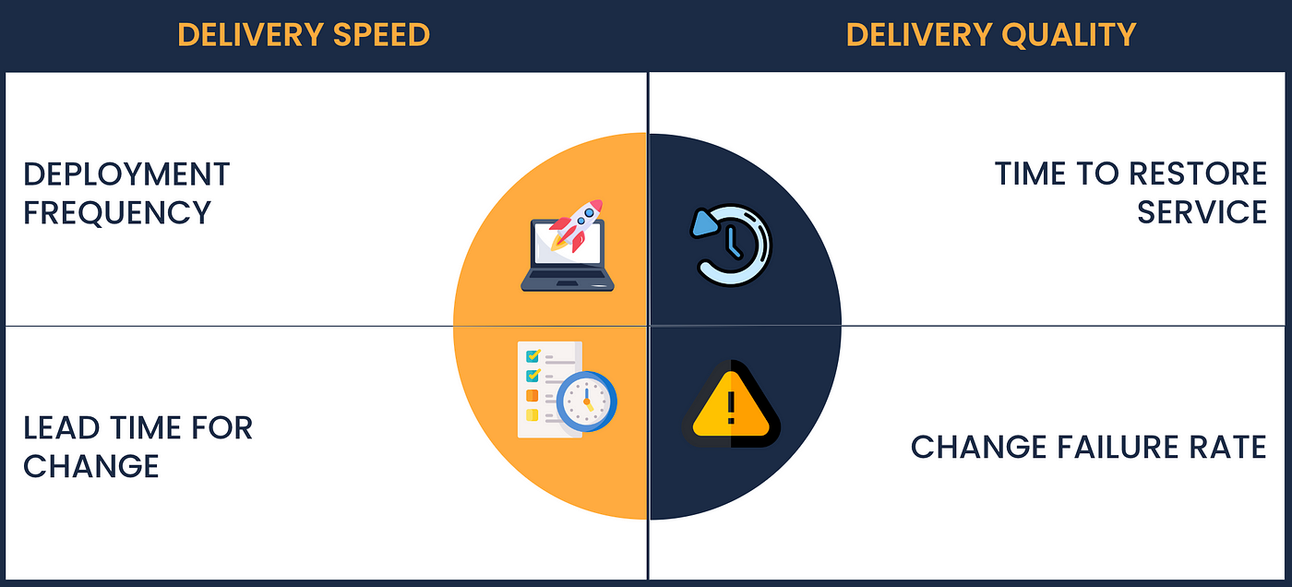
DORA Metrics
Why is rollback important for DORA metrics ?
It reduces time to restore service.
Source: https://medium.com/gits-apps-insight/dora-metrics-how-to-measure-software-delivery-performance-e890ec2011c0

Slide 10

Deployment pipeline best practices
A deployment pipeline should be:
Repeatable
Consistent
Reliable
Same for every environment
Backed up
Extensible
Able to provide feedback
Pipeline as code
Notes:
Repeatable – same steps should be run at every deployment. No matter who commits a code and want to deploy it to Production, the pipeline steps should be the same.
Consistent – the pipeline configuration should be the same every time. If something changes, the change should be committed (in git repository or anywhere else) and every run from that point on should use the new configuration.
Reliable – any gap in the pipeline steps should be fixed ASAP. If the developers don't trust that the pipeline is doing what it is supposed to do, most likely they will avoid using it.
Same for every environment – if there is another team that deploys the code to production, the same steps should be followed.
Backed up – in order to avoid system failures that can lose your pipeline configuration, the deployment pipeline should be backed up. This also helps to know what steps were done at the last deployment.
Extensible – the pipeline will evolve once with the requirements. Keeping it extensible will help evolving new steps for new environments, tests or even regions of deployment.
Able to provide feedback– knowing when the pipeline failed/succeeded will help gaining trust in using it and fixing problems as soon as possible.

Slide 11
Deployment scripting
There are some best practices when it comes to build and deployment scripting:
Create a script for each stage in your deployment pipeline:
General coding best practices apply to pipeline scripts as well:
KISS, YAGNI, SRP, etc.
Composability is usually a good thing to aim for
Use the right tool to deploy the application
Consider all the different users of the pipeline
Pipeline should cover both incremental upgrades as well as rebuilding from scratch

Slide 12
Deployment scripting
Use the same script for all environments
Exercising the same code path minimizes the number of moving parts and increases pipeline predictability
Keep environment-specific code to a minimum
Ensure the deployment process is idempotent
The deployment process should always leave the environment in the same state, regardless of the state it finds it when starting a deployment.
Evolve the deployment system incrementally
Start small and evolve the deployment system in time
Add features and observability in, as needed
Ideally, everyone should (be able to) contribute

Slide 13
Automated acceptance tests
Why are acceptance tests important?
Reduce the cost of manual testing
Reduce the lack of time to do testing when a need for a release appears
They always test the same/all code
Protect the application when doing large-scale changes to it

Slide 14
Automated acceptance tests
Best practices when it comes to acceptance tests:
Keep the tests green – the acceptance tests failure should not be ignored. Either automated rollback are in place or the developer that is deploying the changes should act as soon as possible when the tests fail otherwise the suite will not deliver real value.
Provide actionable results when failing – sometimes, the deployments may happen after many commits. Being able to trace the changes that failed the acceptance tests is a valuable step.
Run the same tests in all environments – having a production-like environment where we can run the acceptance tests before going to production may save us a lot of time and a lot of failed production environments.
Fail fast – running tests for hour may lead to developers forgetting about them and possible issues being ignored

Slide 15
Non-functional requirements
Non-functional requirements are important because they present a significant delivery risk to software projects. Many system fail because they:
Cannot cope with the load applied to them, so the availability goes down to 0
Are not secure
Run too slowly or become unmaintainable because of poor code quality.
Non-functional testing is about, but not limited to, testing:
Capacity
Throughput
Performance
Source: https://www.dnsstuff.com/latency-throughput-bandwidth

Slide 16
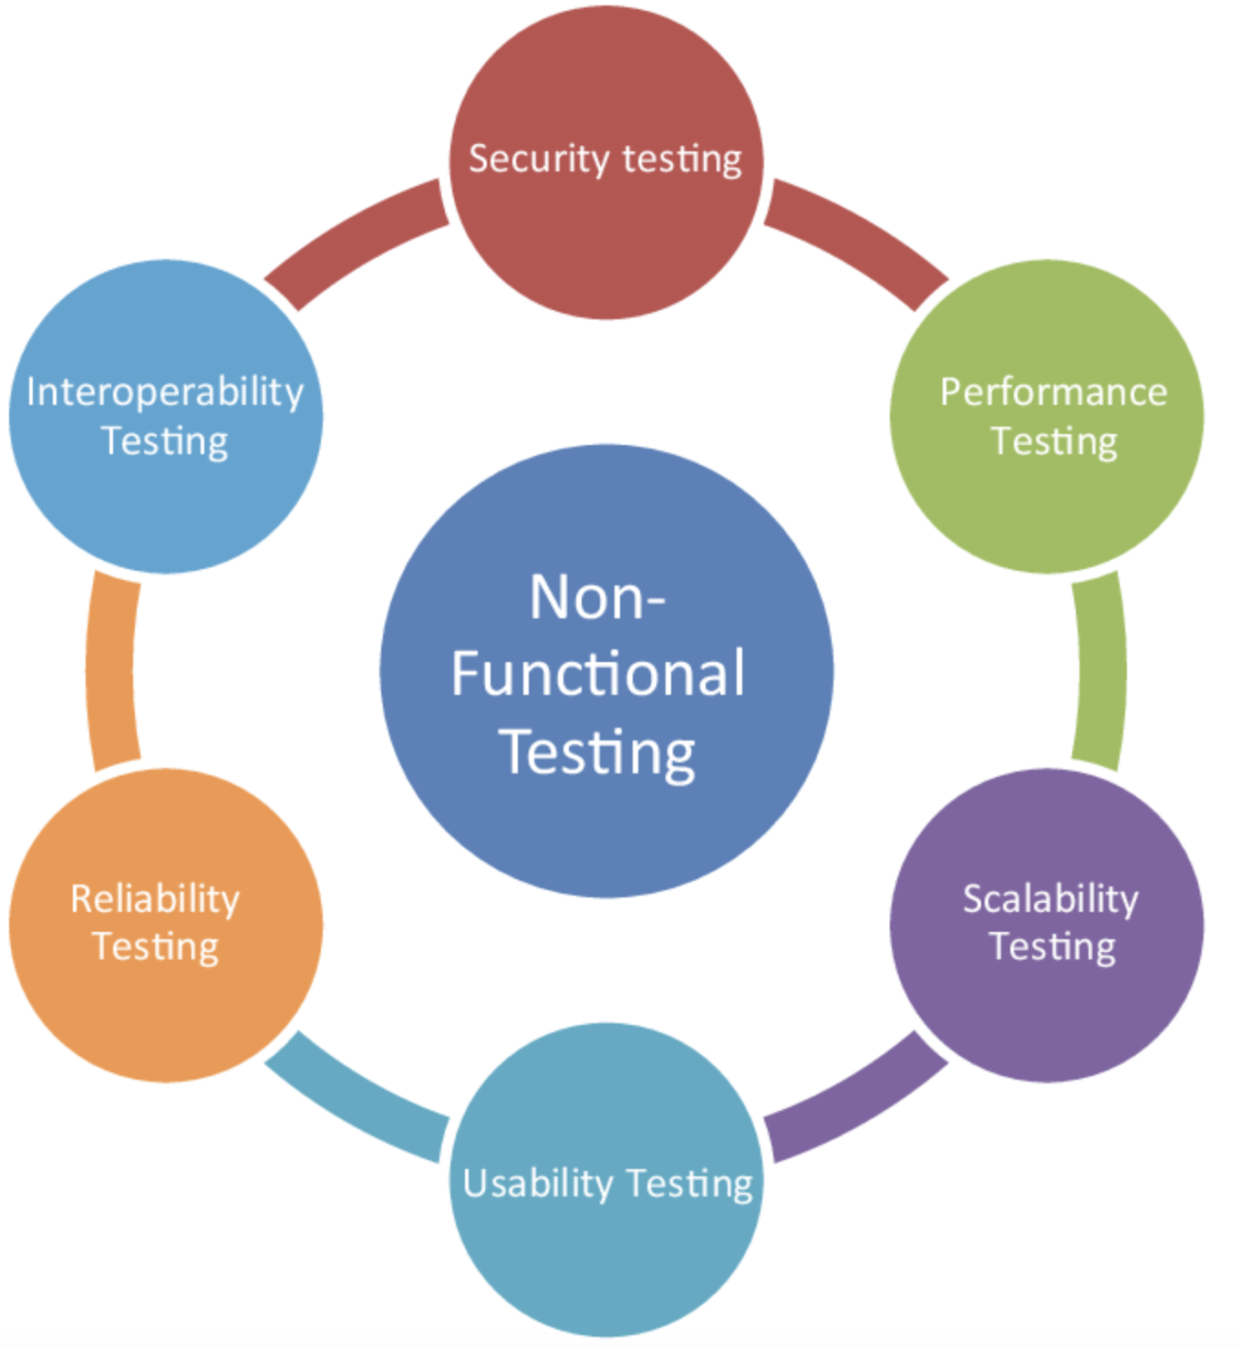
Non-functional testing
Focusing too early and too heavily on optimizing the capacity of the application is inefficient, expensive, and rarely delivers a high-performance system.
There are some ways to address capacity problems:
I/O
Use patterns and avoid antipatterns
Clarity and simplicity in code
Be careful with threading
Source: https://u-tor.com/topic/functional-vs-non-functional
Notes:
When deciding upon architecture for the application, a particular attention should be payed to process and network boundaries and I/O in general.
Make use of patterns and avoid antipatterns that affect stability and capacity of the system.
Encourage clarity and simplicity in code. Never compromise readability for capacity without an explicit test to demonstrate the value.
Be extremely careful about threading.
Create automated tests that assert the desired level of capacity.

Slide 17
Non-functional testing
Measuring capacity involves investigating some characteristics of an application.
Scalability testing – Tells us how the response time of an individual request and the number of possible simultaneous users change as we add more containers or resources (CPU, memory)
Longevity (endurance) testing – Tells us how the applications behave after running it for a period. This can catch memory leaks or stability issues.
Throughput testing – Tells us how many requests per second can the system handle
Load testing – Tells us what happens to capacity when the load on the application increases to production-like traffic.

Slide 18
Deploying and releasing
Deploying and releasing pipeline should have multiple stages:
Deploying to a testing environment
Testing the functional requirements
Testing the nonfunctional requirements
Rolling back if there is any issue with the new image
(Steps above can be repeated for as many environments are needed)
Deploying to Production – Release
Testing the functional requirements
Rollback all environments if there is any issue in production, start with the production one
*Testing the nonfunctional requirements is done only in environments that are not production.

Slide 19

Deployment Stategies
Blue Green deployment
Canary deployment
v2.4.0
v2.4.1
v2.4.0
v2.4.1
v2.4.0
v2.4.1
v2.4.0
v2.4.1
v2.4.0
v2.4.1
v2.4.0
v2.4.1
Notes:
Blue Green deployment:

Slide 20
DORA Metrics
How deployment stretegies impact DORA metrics ?
Blue Green deployment – fast restore
Canary deployment – fast restore for part of the users
Source: https://medium.com/gits-apps-insight/dora-metrics-how-to-measure-software-delivery-performance-e890ec2011c0

Slide 21
Continuous delivery
Continuous delivery is achieved by continuously integrating the software done by the development team, building executables, and running automated tests on those executables to detect problems.

Slide 22
Managing infrastructure and environments
What is an environment?
An environment is all the resources that your application needs to work and their configuration. The following attributes describe the environment:
The hardware configuration of the servers that form the environment (such as the number and type of CPUs, amount of memory, etc.) and the networking infrastructure that connects them
The configuration of the operating system and middleware (such as messaging systems, application and web servers, database servers) required to support the applications that will run within it
What is infrastructure?
The infrastructure represents all environments in the organization, along with the services that support them, such as DNS servers, firewalls, routers, version control repositories, storage, monitoring applications, mail servers, etc.

Slide 23
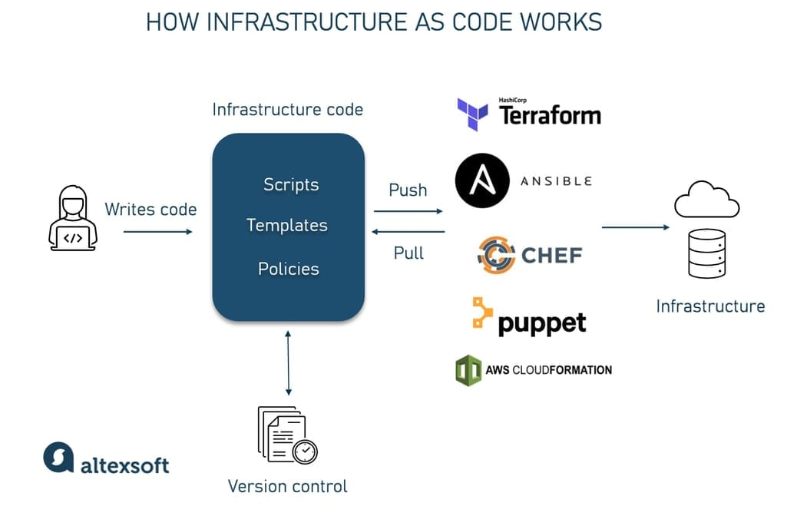
Managing infrastructure and environments | IaC
Infrastructure as Code (IaC) is the process of managing your IT infrastructure using automatic scripts instead of manually
https://www.altexsoft.com/blog/infrastructure-as-code/
Notes:
The desired state of your infrastructure should be specified through version-controlled configuration.
Infrastructure should be autonomic—that is, it should correct itself to the desired state automatically.
Infrastructure should be simple to re-create for the cases of hardware failure for example.
Every person involved(operations, developers, testers etc.) should always know the actual state of your infrastructure through instrumentation and monitoring.
Infrastructure should be monitored and alerts must be in place for abnormal events.

Slide 24
Managing data
Database scripting
Database initialization and migrations need to be captured as scripts and checked to version control repository
The schema of a database will evolve along with the application, so it is crucial to have a certainty that the database has the correct schema to work with a particular version of your application.
Incremental changes
Databases should be versioned. Every time a change is made to the database, two scripts should be added:
One that takes the database from version x to x + 1
One that takes the database from version x + 1 to x

Slide 25
Managing data | Test data
There are some guidelines we need to follow when defining data for manual or automated tests:
The data should allow us to simulate common interactions with the system
The data should test edge cases that will prove the application works under unusual inputs
The test data should contain scenarios for error conditions so that the application response under those circumstances is evaluated.
The concerns we want to evaluate when managing test data are the followings:
When testing performance, we want to keep the tests run as fast as possible. For unit tests, this means we need to run them against an in-memory DB or no DB at all.
Test isolation should be taken into consideration. DB have persistent storage, so the data is persisted between tests. This needs to be avoided to run the tests in an environment where we can control the inputs so that we can easily evaluate its outputs.

Slide 26
Managing components and dependencies | Components
What is a component?
A component is a reasonably large-scale code structure within an application, with a well-defined API, that could potentially be swapped out for another implementation.
The antithesis of a component-based system is a monolithic system with no clear boundaries or separation of concerns between elements responsible for different tasks.
One of the most important things to watch when working with components is to keep your application releasable. There are some strategies to achieve this:
New functionality is hidden until it is completed.
All changes should be made incrementally as a series of small changes, all of them releasable.
Components should be used to decouple parts of the application that change at different rates.
Branch by abstraction should be used for large-scale changes to the codebase.

Slide 27
Managing components and dependencies | Dependencies
A dependency occurs whenever one piece of software depends upon another to build or run
There are two distinctions that are useful:
The distinction between components and libraries:
The distinction between build-time and runtime dependencies:
Managing dependencies can be difficult. Some common problems are:
The application depends on a particular version of something, but it is deployed with a different one. Very important: Always use versioning.
Managing libraries. Easiest way is to use a tool like Maven, Ivy, Gradle. Very important: Pin your dependencies.
Notes:
Libraries refer to software packages that are not in the team's control.
Components are pieces of software that the application depends upon, that are developed by the same team or other teams in the organization.
Build-time dependencies must be present when the application is compiled and linked.
Runtime dependencies must be present when the application runs

Slide 28
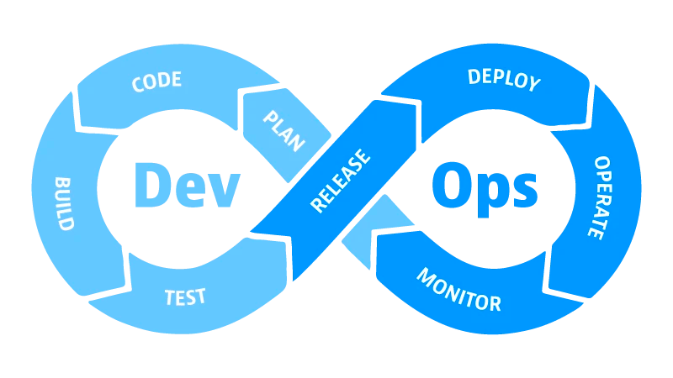
DevOps
DevOps is a set of practices, tools, and a cultural philosophy that automates and integrates the processes between software development and IT teams
DevOps has become an essential part of software development, allowing organizations to develop and deploy software faster and more efficiently. However, measuring the success of DevOps initiatives can be challenging. That’s where DORA metrics come in.
Source: https://medium.com/gits-apps-insight/dora-metrics-how-to-measure-software-delivery-performance-e890ec2011c0

Slide 29
Am I doing CD?
Is your software deployable throughout its lifecycle?
Does your team prioritize keeping the software deployable over working on new features?
Can anybody get fast, automated feedback on the production readiness of their systems any time somebody makes a change to them?
Can you perform push-button deployments of any version of the software to any environment on demand?

Slide 30
References
Continuous Delivery: Reliable Software Releases through Build, Test, and Deployment Automation, by David Farley, Jez Humble
Continuous Delivery, Martin Fowler - https://martinfowler.com/bliki/ContinuousDelivery.html
Grokking Continuous Delivery, Christie Wilson – Manning Publications, October 2022

